Slide 1
Techniques to secure data on cloud: Docker swarm or Kubernetes?
By Sashwat

Slide 2
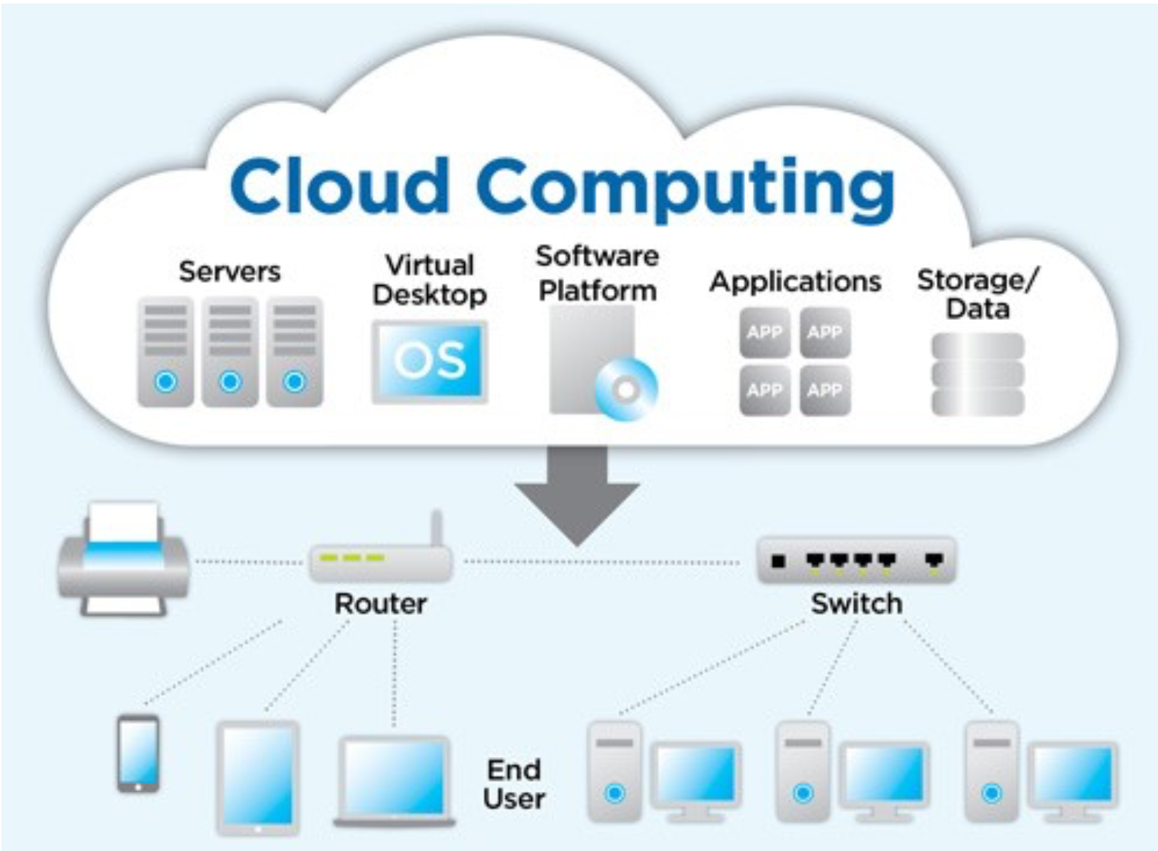
What is Cloud Computing?
Introduction
A Cloud Computing model is a model which enables convenient, on demand network access to a shared pool of configurable computing resources and services.
The resources includes:-
Network
Storage
CPU cores
RAM

Slide 3
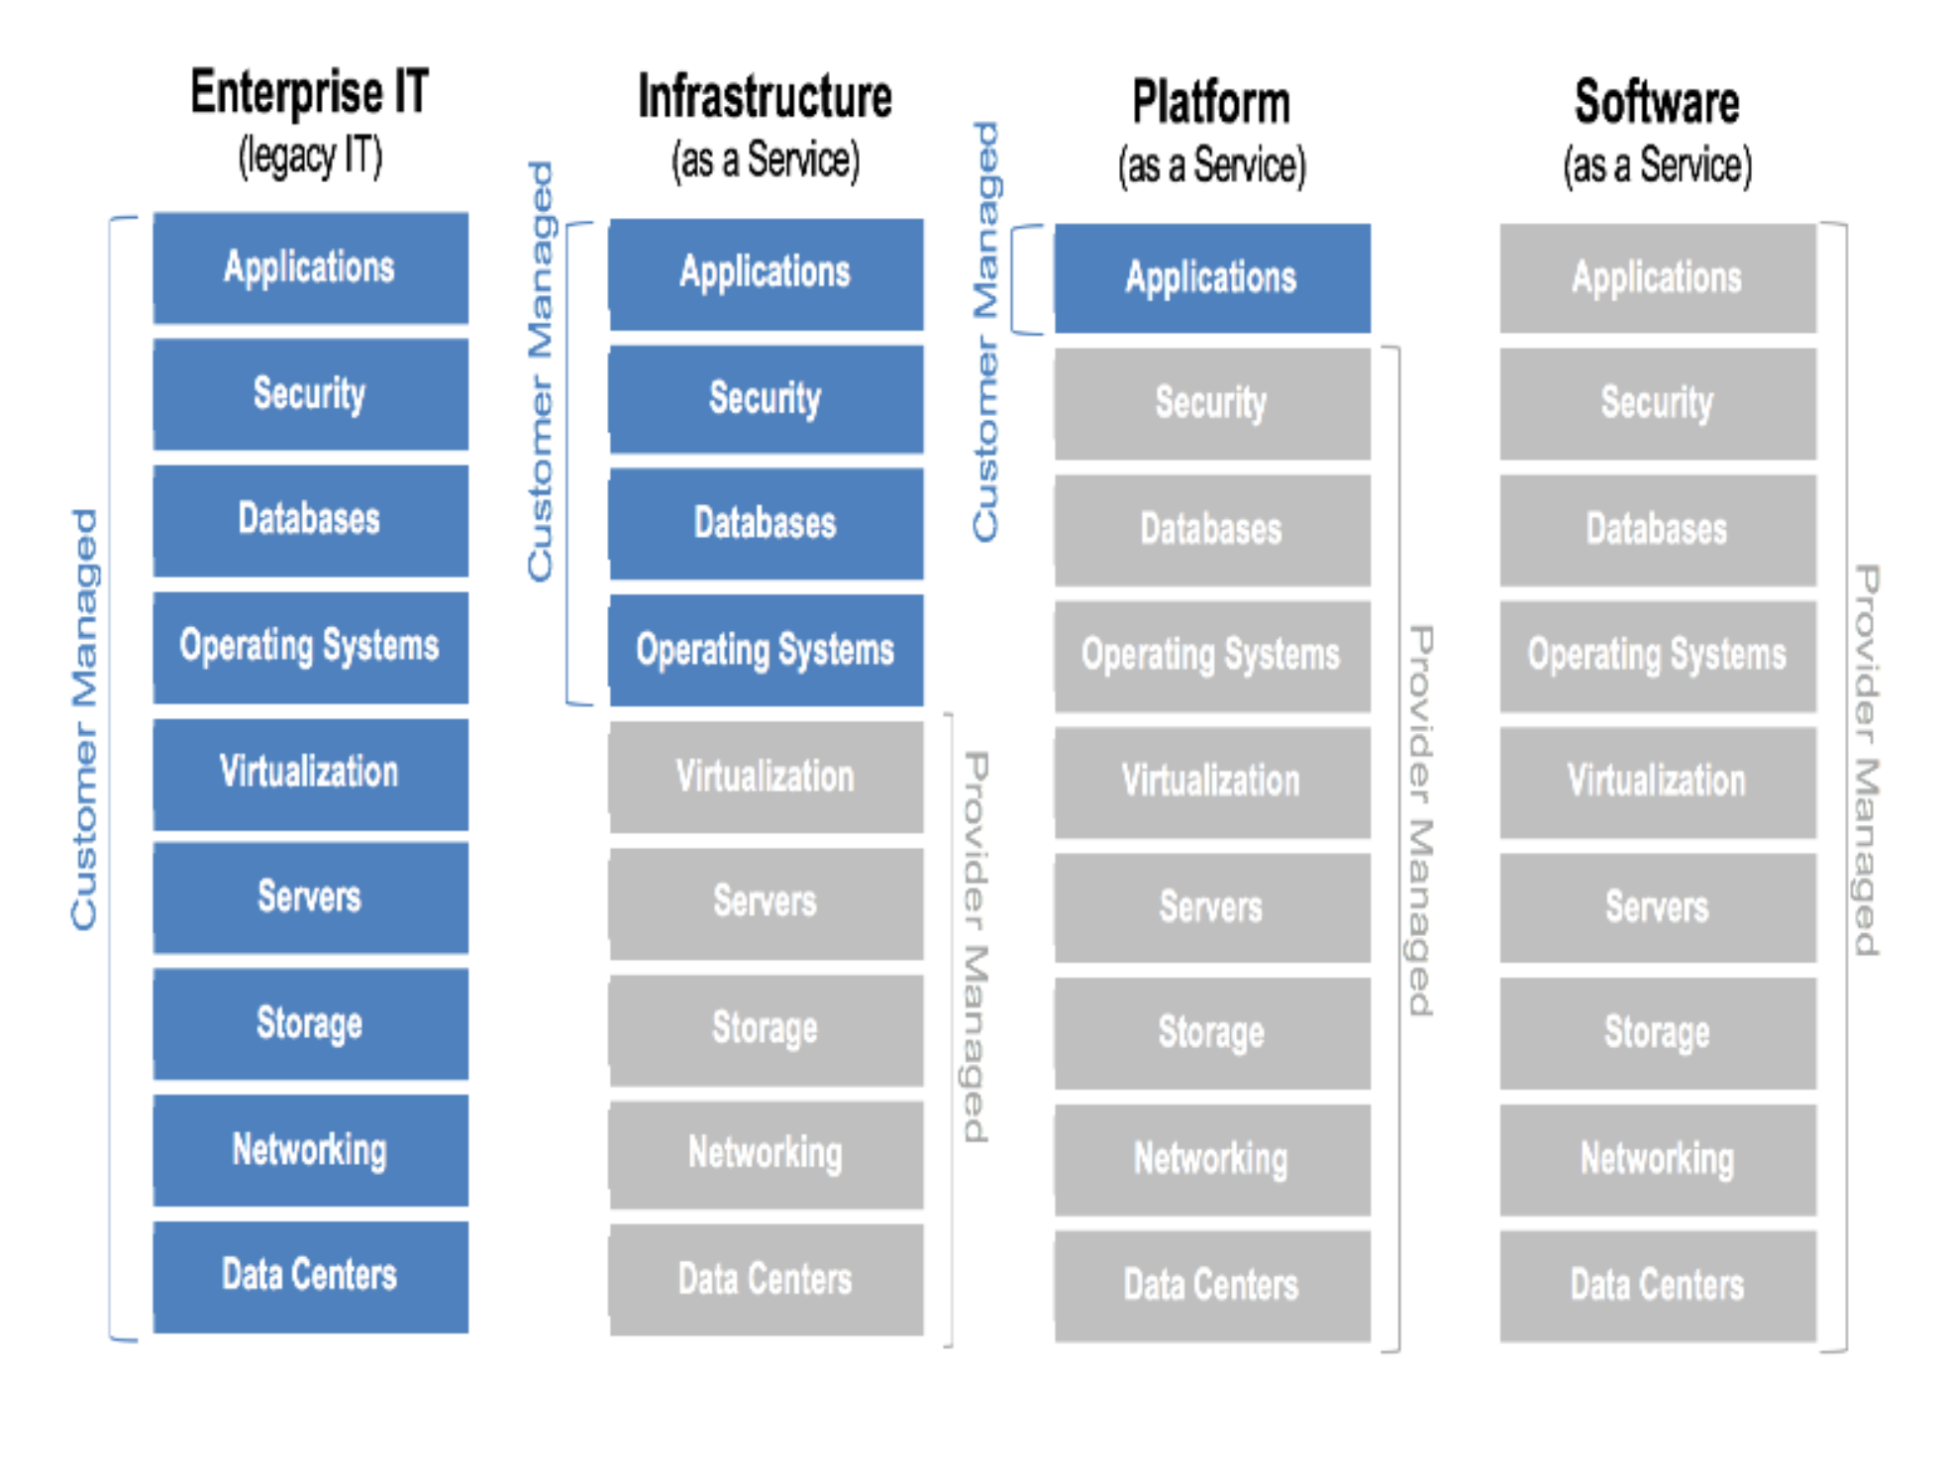
Cloud computing Service Model
Introduction
Infrastructure as a Service (IaaS)
Platform as a Service (PaaS)
Software as a Service (SaaS)

Slide 4
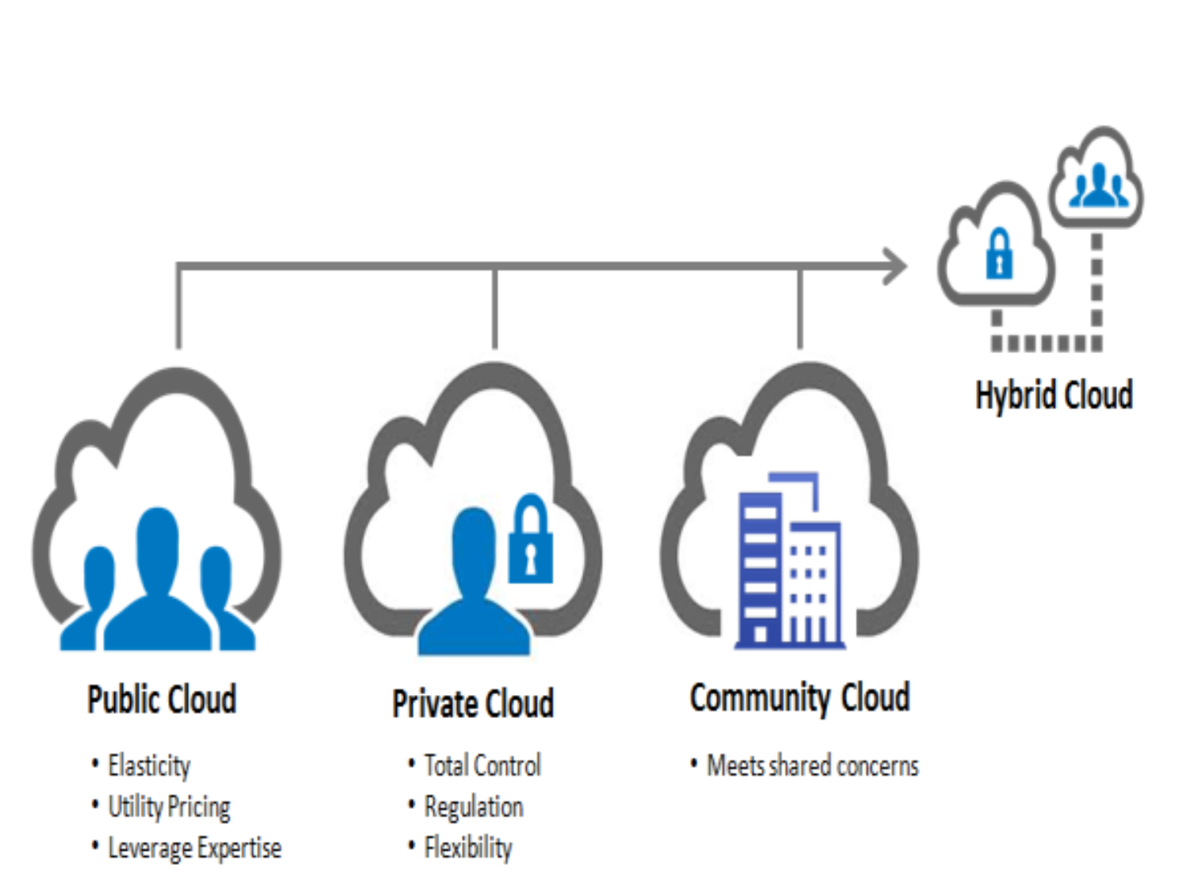
Cloud computing Deployment Model
Introduction
Public cloud
Private cloud
Community cloud
Hybrid cloud

Slide 5
Security
INTRoduction
Three principles of cloud security:-
Availability
Confidentiality
Integrity
Best security method - Cryptography, RSA algorithm and Container clustering
Kubernetes and Docker swarm are technologies that use container clustering

Slide 6
What is Container?
INTRoduction
A container image is a lightweight, stand-alone, executable package of a piece of software that includes everything needed to run it: code, runtime, system tools, system libraries, settings.
It is platform independent.

Slide 7
What is Docker?
Introduction
Docker is a set of platform-as-a-service products that use OS-level virtualisation to deliver software in packages called containers.
Core DevOps tool.
Docker is the next step from virtualisation. Before virtualisation, all the features where deployed in one server.

Slide 8
Advantages of Docker?
Introduction
Continuous deployment and testing.
Multi-Cloud platform (Available in AWS, DigitalOcean etc).
Environment standardisation and version control.
Isolation (Kernel Level).
Security.

Slide 9
Relationship between cloud computing and docker?
Introduction
Docker with PaaS.
Fundamental unit / Feature by cloud providers.
Eg: AWS, DigitalOcean etc.
Docker with IaaS.
Docker deployed on Virtual Machine.
Eg: Docker on a VM.

Slide 10
Why use docker swarm or kubernetes over docker?
Introduction
Coordination
Scheduling
Orchestration
Best use for large scale environment.

Slide 11
Docker swarm VS KUBERNETES
Introduction
Networking:-
Docker swarm: Node model. Creates a overlay network for the containers and a host only bridge for communication.
Kubernetes: Flat network. Allows interaction with each other.

Slide 12
Continue..
Introduction
High Availability:-
Docker swarm: Load balancing detects unhealthy pods and removes it.
Kubernetes: Controls entire cluster and handles worker node’s resources.

Slide 13
Continue..
Introduction
Container setup:-
Docker swarm: Native tools support for docker
Kubernetes: YAML, APIs and client definitions. Cannot use Docker compose.

Slide 14
Container clustering and glusterFS
Techniques to secure data on cloud
Network file system developed by RedHat.
Used for storing data in clusters.
Process: Stripping or replicating or both.

Slide 15
Encryption over cloud model and its process using container
Techniques to secure data on cloud
Swarm manager
Send plain text (Unencrypted) to a container running Docker Cryptography Container.
Gateway Server
Uses SSH for communication.
Gateway Manager
Data stored to make highly available.

Slide 16
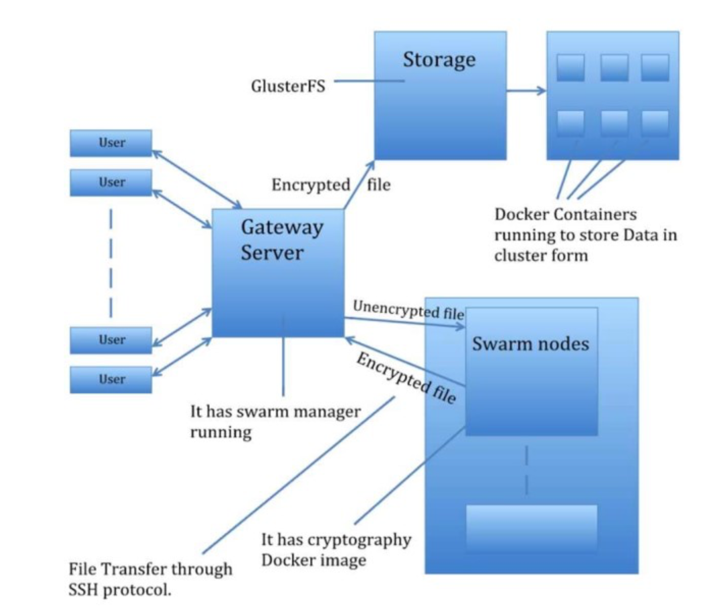
Continue..
Techniques to secure data on cloud
GlusterFS:-
Stores data to multiple docker containers.

Slide 17
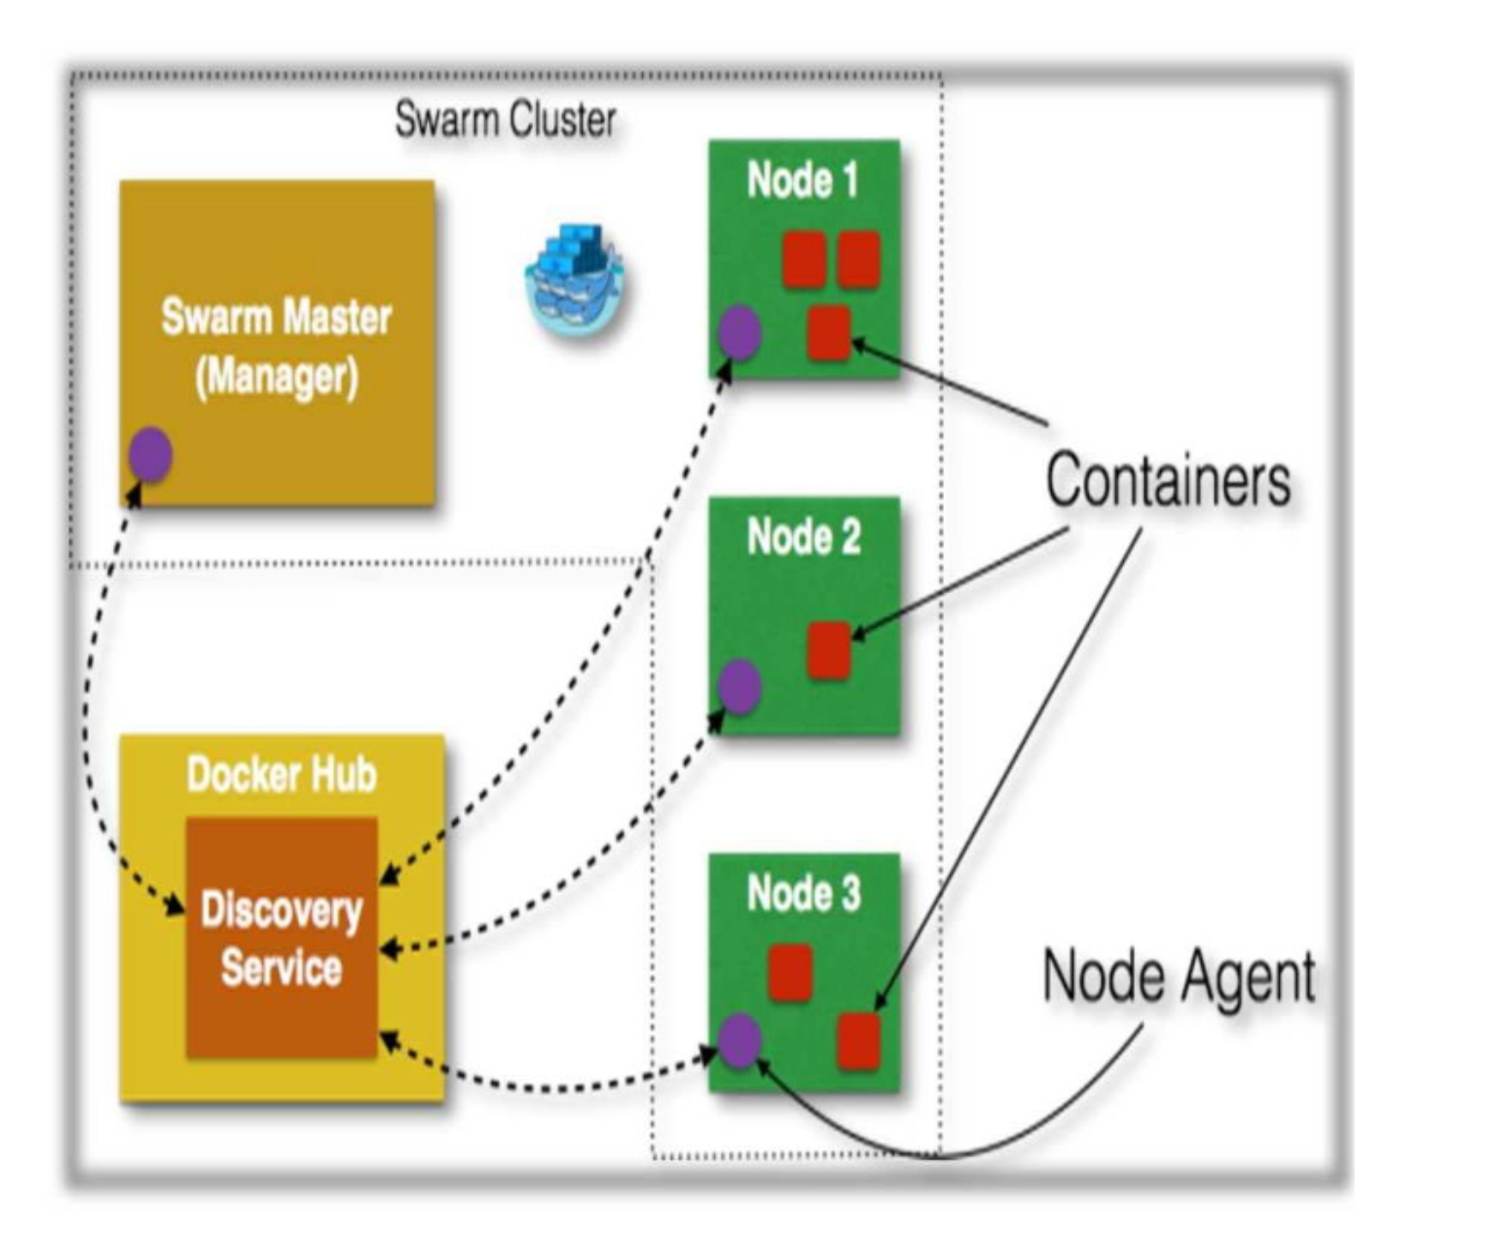
SWARM MODEL
Docker

Slide 18
USIng kubernetes instead of docker swarm
Techniques to secure data on cloud
More efficiency.
Better power, performance and flexibility in container management.
Better optimisation for the existing model.

Slide 19
Conclusion
Conclusion
Cloud computing is very popular and are more prone to cyber threats.
So securing the cloud is a necessity.
The technology of containers is used to secure data that is being uploaded to the cloud.
For each user a container can be used to manage encryption / decryption of user data.
Kubernetes is better for this model due to its shear strength.

Slide 20
Thank You

